Slide 1
Automation Process with Workiva
Presented by:

Slide 2
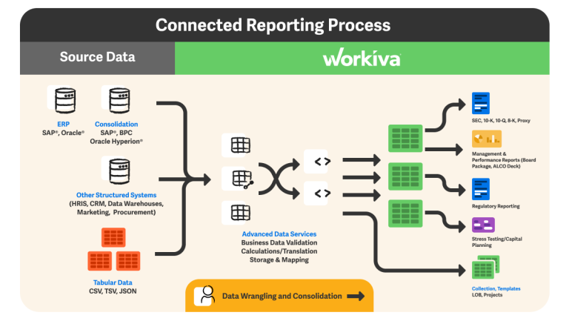
What is Workiva?
Utilized by the Office of Accounts and Controls (A&C), Workiva supports Wdesk, a cloud-based, compliance reporting and management software that provides key functions for streamlining Federal/State financial reporting processes.
Wdesk allows users to centralize work across financial reports, such as the Annual Comprehensive Financial Reports (ACFR). Along with any additional fiscal/year-end reports.
Along with simplifying financial reporting processes, Wdesk offers a new feature called “Certifications”.

Slide 3
Certifications with Wdesk
A “process” is a file type that Workiva offers which users design and automate the workflows.
Within a process file, users can create a “Certification” or workflow that automatically sends tasks to assignees; helping efficiently collect and review content, and to track current assignments.
Assignments can range from a simple questionnaire Word document, to a complexed Excel spreadsheet; Workiva’s cloud-based application provides plenty of storage for files.
A key factor to the automation process of Wdesk is Ordered Signer. This feature allows for A&C to establish users to complete a task; then once the specific users complete the task, the next specified user will receive/submit the same document. Essentially having the document be completed by each agency hierarchy (if established).

Slide 4
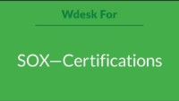
Intro to Certifications Video

Slide 5
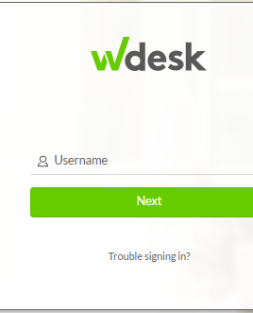
Why you need to know?
A&C will start to begin utilizing the Certification feature to disburse, track, and review documents that were typically submitted to A&C via email.
CFOs and other agency personnel designated to complete such fiscal & year-end reports, will be asked to complete these files via Wdesk.
To complete these files, you will receive an email (via Workiva) asking to review and certify a specific document:
Simply click the link in the email, which will bring you to the Wdesk login screen.
Click “Trouble signing in?” and enter your username (your email address).
This will send you an email to reset your password.
Please follow the link in order to successfully reset password, then login and complete reports/forms.
Please email questions to: Anthony.Venditelli@doa.ri.gov Alexander.Herald@doa.ri.gov

