Slide 1
Service Organization Control Reports
Report Review Training – April 2022
Department of Administration – Office of Accounts and Control

Slide 2
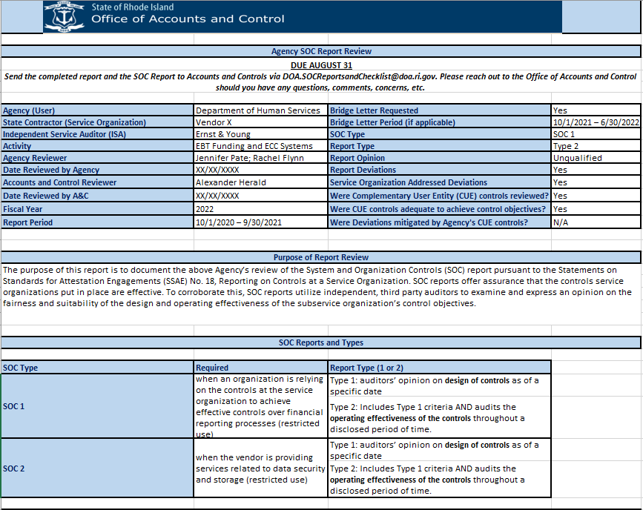
Purpose
This presentation is ONLY to provide information and guidance on the new Service Organization Control (SOC) Report Review required by the Office of Accounts and Control (A&C)
For a basic understanding of SOC reports and why they are important, please review the Office of the Auditor General (OAG)’s presentation from June 17, 2021

Slide 3
Service Organization Control Reports
Training on June 17, 2021
Presentation:

Slide 4
Report Review over Checklist…WHY?
Audit findings require Agencies to evaluate SOC reports more thoroughly
Continued improvement/training is recommended and best practice
Report Review is more like a memo and gives vital information not included in the checklist

Slide 5
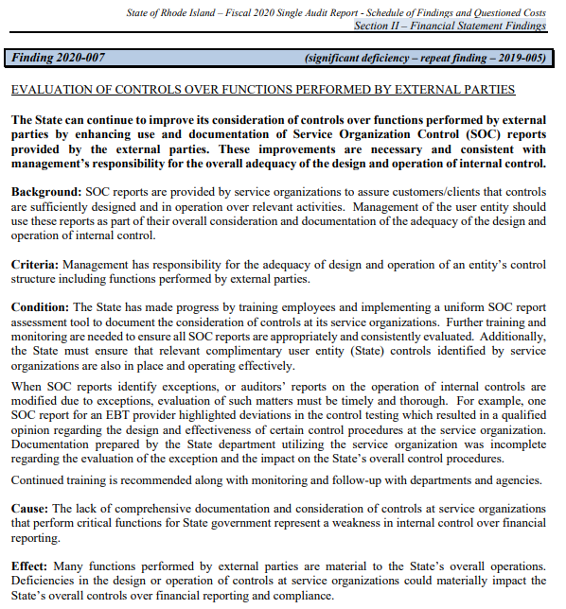
Office of the Auditor General: Repeat Findings on SOC Reporting
Finding 2020-007 (significant deficiency – repeat finding – 2019-005)
“The State can continue to improve…by enhancing use and documentation of SOC reports”
The OAG recommends:
Enhancing training and monitoring
Identifying complimentary user entity (State) controls are in place and operating effectively
Ensuring expectations and auditor report modifications are evaluated and documented timely as they relate to the State’s overall control procedures
The new SOC Report Review will aid agencies in accomplishing these recommendations
Notes:
Since 1/14 version:
-2.6M Expenses due to Surge AHS Lifespan Invoices
Notes from 1/14:
+7.1M PE
-3M Surge - AHS Accruals (prior period adjustment for hospital invoices)
+10.9M State Personnel Expenses
-1.1M Education - Ed Consultant
Majority of the encumbrances on the books don't seem to be "real" since the PE for these LS's are fully spent. The Only "real" encumbrances are ~$3.5M in state personnel expenses (LS 4676204)
$2.7M of FY23 encumbrances are not yet encumbered from the emergency staffing

Slide 6
What does the Report Review include
A Summary table of all key information (like the Checklist previously utilized)
Purpose of Report Review
A table of SOC reports and types
Agency (User) Background
State Contractor (Service Organization) Background
Activity Background
Procedures performed and scope of Agency’s review
Period covered by the SOC Report
Qualifications on Control Objectives (aka the opinion by the Independent Service Auditor)
Independent Service Auditor (ISA) Background
Subservice Organizations included in the scope of the report
Any scope limitations described in the report
Deviations noted in tests of internal controls by the ISA and Service Organization’s responses
Agency response to Deviations/Opinion other than Unqualified
Complimentary User Entity Controls (CUE controls)
Disaster Recovery
Notes:
As of 1/15 the following FTE were being provided via the Emergency Staffing Vendor:
Vets -> 16 FTE
ESH -> 26 FTE
Existing expenditures for State Personnel and Government readiness are still being reconciled.

Slide 7
Summary Table has checklist criteria included…
The main table of the Report Review includes information previously required by the Checklist
This portion of the report is meant to be a quick summary of all relevant information related to the SOC report
Can be utilized by the OAG for audit purposes
But we’re not finished yet ☺…

Slide 8
Purpose of Report Review
NOTE: No information required by Agency in this section
Gives insight into what the purpose of the SOC report is
Context for why Agencies rely on and review these reports
Assists non-accounting personnel to understand what the report is and what the goal of the report is

Slide 9
SOC Reports and Types
NOTE: No information required by Agency in this section
Quick summarization of SOC Reports and Types
Assists non-accounting personnel gain understanding

Slide 10
Agency (User) Background
Provide a short summary of the Agency and its mission
Assists reviewers to gain insight into what the Agency does
This information helps provide context within the overall SOC Report Review

Slide 11
State Contractor (Service Organization) Background
Provide a short summary of the State Contractor (Service Organization) and the services it provides
Assists reviewers to gain insight into what the Service Organization does
This information helps provide context within the overall SOC Report Review

Slide 12
Activity Background
Provide a short summary on the activity(ies) that the Service Organization is contracted to perform on behalf of the Agency
Assists reviewers to understand what the Service Organization does for the Agency
This information helps provide context within the overall SOC Report Review

Slide 13
Procedures Performed and Scope of Agency’s Review
NOTE: No information required by Agency in this section
Lists the information reviewed and documented by the Agency regarding internal controls
Most of this information is found within the SOC report

Slide 14
Period covered by the SOC Report
Provides the time period covered by the SOC report
A Bridge Letter is required if the time period does not cover the State’s fiscal year (7/1 – 6/30)
A Bridge Letter is provided by the Service Organization attesting to a time period not covered by the SOC report
If the bridge letter states the Service Organization is aware of material changes to the control environment since the SOC report, please contact A&C to discuss next steps

Slide 15
Qualifications on Control Objectives
Provides the Independent Service Auditor (ISA)'s opinion on the Service Organization's internal controls
Agency should state their comfort level with that opinion
Types of Auditor Opinions:
Unqualified - indicates a clean opinion (aka no significant/material issues) on internal controls, sometimes called 'unmodified’
Qualified - indicates issues that were significant enough to deem one or more controls ineffective
Disclaimer - indicates sufficient audit evidence could not be obtained to issue an opinion
Adverse - indicates users of the SOC report can not place any reliance on the service organization's system
An opinion other than unqualified should raise a red flag
However, even ‘clean’ opinions can have deviations (or errors) that need to be reviewed to determine risk to Agency

Slide 16
Independent Service Auditor Background
Provides a brief description of the Independent Service Auditor (ISA)’s background
Can be found on the ISA’s website
Sometimes information about the ISA can be found on the SOC report
Purpose is to review and document that the ISA is reputable and capable of performing the SOC report work

Slide 17
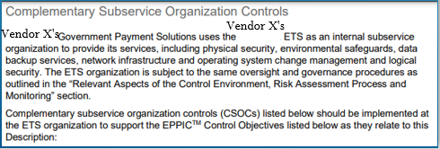
Subservice Organizations included in the scope of the report
Agency should determine if the Service Organization is reliant upon a Subservice Organization’s internal controls
Typically discussed in the Scope paragraph by the ISA and within its own ‘Subservice Organization’ section if applicable
If the answer is yes, Agency is required to request the Subservice Organization’s SOC Report and document the opinion in this section
Note: documenting the opinion of the Subservice Organization’s SOC Report should be sufficient
SOC Report

Slide 18
Any Scope Limitations described in the report
Document any scope limitations mentioned in the SOC report
What is a Scope Limitation?
A scope limitation is a restriction on an audit that is caused by the client, issues beyond the control of the client, or other events that do not allow the auditor to complete all aspects of his or her audit procedures
Often scope limitations lead the ISA to issue a less than ‘clean’ or unqualified opinion

Slide 19
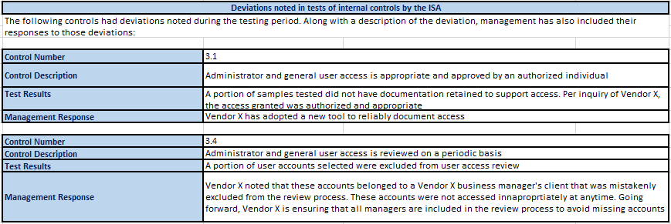
Deviations noted in tests of internal controls by ISA
Document all deviations in the SOC Report using the format below
Descriptions of the deviations can be brief
Important information includes:
Control Number
Type of Control
Test results aka the deviation; and
Management’s response to that deviation

Slide 20
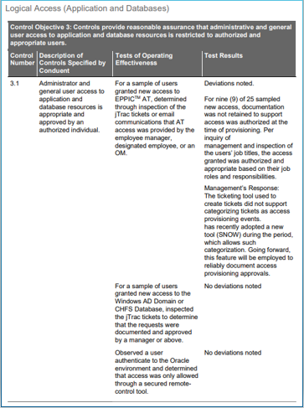
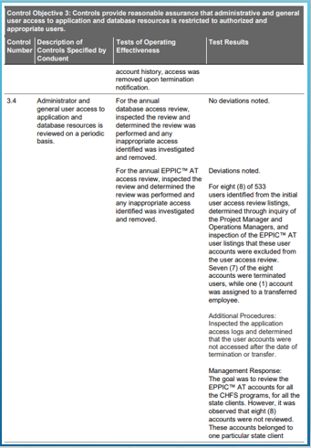
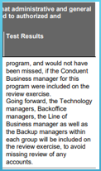
Deviations noted in tests of internal controls by ISA (continued)

Slide 21
Agency response to deviations
Document the Agency's response to all deviations in the SOC report
Depending on the nature of the deviation, their relevance to the Agency's mission, and the Service Organization's response to these deviations, the responses here may vary
It may be sufficient to respond to the deviations overall or it may require the Agency to discuss each deviation separately
Discussion should include why the Agency is comfortable with a deviation (i.e. agency has X control in place to mitigate the risk) or why the Agency may need to consider additional controls to ensure that deviations are mitigated effectively

Slide 22
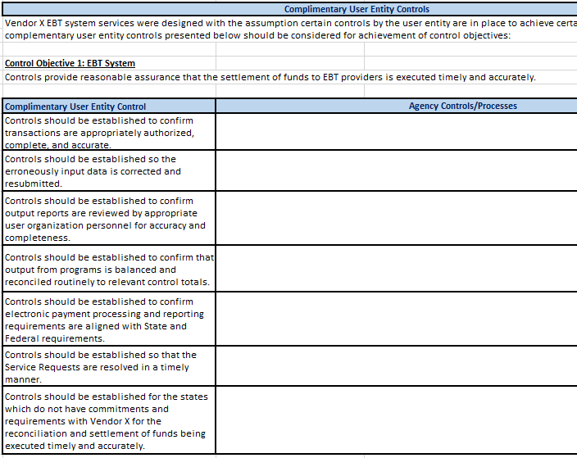
Complimentary User Entity (CUE) Controls
Review the complementary user entity controls (CUEs) that the Subservice Organization assumes are in place at the Agency to achieve control objectives
The goal is to fill in each of the CUE controls with the Agency's controls and processes.

Slide 23
Complimentary User Entity (CUE) Controls – Guidance on Responses
The CUE controls are not meant to be an exhaustive list, but rather a list of controls the Agency should consider having in place to meet their control objectives
Responses should be as brief and summarized as possible:
Focus on capturing the key elements of the controls/processes
Example:

Slide 24
Complimentary User Entity (CUE) Controls – Guidance on Responses PT. 2
It's possible that your controls/processes cover multiple CUE controls, if so its O.K. to copy and paste that same control/process to the applicable CUE
If a listed CUE control is not relevant to the Agency's processes, please provide information on why the control/process is not needed
If you have any questions regarding CUE controls and how they relate to your agency's controls/processes, please reach out to A&C via DOA.SOCReportsandChecklist@doa.ri.gov

Slide 25
Disaster Recovery
Document the Service Organization’s disaster recovery plan
Purpose is to review and ensure that the Agency’s data is protected and preserved by the Service Organization in unforeseen events
Also ensures that the Service Organization can continue to operate effectively for the Agency

Slide 26
Review Signatures
And last but certainly not least…
The Agency should do a final review and sign off on the SOC Report Review
Please provide to A&C the following:
Signed copy (in PDF form)
The excel version of the report review
All SOC reports

Slide 27
Thank You!
Any questions, please do not hesitate to reach out to A&C via DOA.SOCReportsandChecklist@doa.ri.gov
Alex Herald, Administrator, Financial Management Alexander.Herald@DOA.ri.gov

