Slide 1
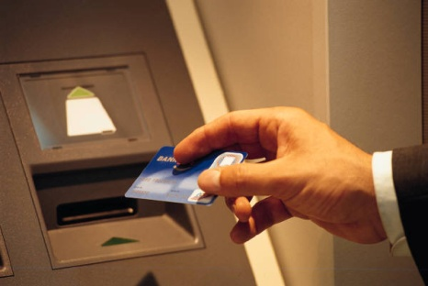
Cardholder Readiness
PaymentNet® Migration
PaymentNet Cardholder Training
A script for this presentation can be found in the Notes Page View.
What Cardholders Need to Know to Result in a Successful Migration
Notes:
This slide presentation will provide an overview of some of the new functionality and changes found in the updated PaymentNet platform.
Instruction for the Program Administrator:
Note that this course has been designed to be used in two unique ways:
The Program Administrator may choose to use this PowerPoint training presentation as developed to personally train their Cardholders. There is a fully-scripted Notes Page found below each slide to direct the training discussion with your Cardholders.
OR
The Program Administrator may choose to send this PowerPoint training presentation directly to their Cardholders as an independent and self-standing resource tool. There is a fully-scripted Notes Page found below each slide to direct the training discussion with your Cardholders.
REMINDER: You must select the Notes Page when printing this PowerPoint Presentation to get the full script.
Additionally, each organization may choose to use this in addition to any other training materials developed for their Cardholders. You may also edit, delete or add to this presentation as appropriate for your organization.

Slide 2
This presentation was prepared exclusively for the benefit and internal use of the J.P. Morgan client to whom it is directly addressed and delivered (including such client’s subsidiaries, the “Company”) in order to assist the Company in evaluating, on a preliminary basis, certain products or services that may be provided by J.P. Morgan. This presentation contains information which is confidential and proprietary to J.P. Morgan, which may only be used in order to evaluate the products and services described herein and may not be disclosed to any other person. In preparing this presentation, we have relied upon and assumed, without independent verification, the accuracy and completeness of all information available from public sources or which was provided to us by or on behalf of the Company or which was otherwise reviewed by us.
This presentation is for discussion purposes only and is incomplete without reference to, and should be viewed solely in conjunction with, the oral briefing provided by J.P. Morgan. Neither this presentation nor any of its contents may be used for any other purpose without the prior written consent of J.P. Morgan. J.P. Morgan makes no representations as to the legal, regulatory, tax or accounting implications of the matters referred to in this presentation.
Notwithstanding anything in this presentation to the contrary, the statements in this presentation are not intended to be legally binding. Any products, services, terms or other matters described in this presentation (other than in respect of confidentiality) are subject to the terms of separate legally binding documentation and/or are subject to change without notice.
Neither J.P. Morgan nor any of its directors, officers, employees or agents shall incur any responsibility or liability whatsoever to the Company or any other party in respect of the contents of this presentation or any matters referred to in, or discussed as a result of, this document.
J.P. Morgan is a marketing name for the treasury services businesses of JPMorgan Chase Bank, N.A. and its subsidiaries worldwide.
© 2013 JPMorgan Chase & Co. All rights reserved
Notes:
Disclaimer Slide
As this presentation is the property of JPM Chase, we ask that it be used with the intent in which it was developed.
This slide outlines the confidentiality statement associated with this training content.
Materials presented are considered proprietary and confidential information related to PaymentNet, and we ask that you consider that when you’re deciding what to share with others within your organization.
Please note that our intention is not to limit the critical information that you share. Share what you need to with whoever needs to the information in your organization.

Slide 3
Why Change to a New Platform?
What is happening to Legacy PaymentNet?
It is being sunsetted after almost15 years
Why?
Technical Advances
Increased Functionalities
Who is impacted?
Everyone who logs on to PaymentNet
What’s replacing Legacy PaymentNet?
An updated platform
New User Interfaces
When is this happening?
After our organization’s training and migration
Notes:
As Cardholders you may have some questions about why our organization is moving to an updated platform. Let’s answer some of these questions for you now.
What is happening to Legacy PaymentNet? Legacy PaymentNet is being sunsetted after almost 15 years and is being replaced with a platform that is similar but updated, enhanced and more flexible.
Why? Cardholders have been asking for increased functionalities and technical advances that Legacy could not provide.
Who is impacted? All users of Legacy PaymentNet will be impacted.
What’s replacing Legacy PaymentNet? PaymentNet will be moving to an updated platform going forward with new user interfaces.
When is this happening? As soon as our organization completes the necessary migration activities, i.e. including this training.

Slide 4
…and then what happens?
Similar Processes
Easier Navigation
Enhanced Support Options
Increased Functionality and Features
Notes:
And then what happens?
After our migration to the new platform, you will notice some immediate benefits. As Cardholders you will find similar processes for completing tasks you are most familiar with. You will also find a more intuitive and user-friendly experience and enhanced support options including self-help tools to empower your own learning as you move from screen to screen. There is increased functionality and new features that will enhance your daily activities.
Let’s discuss ‘What’ this means to you.

Slide 5
What Needs to be Understood?
Identify the “What’s”
Processes
Procedures
Behaviors
Roles
Tasks
Notes:
To prepare you for this platform migration, we will identify what changes you can expect to see regarding your current processes and procedures. We will train you on how to perform your tasks successfully going forward. This may require that you adopt a change in your behavior and role when compared to how you are doing things today.
Let’s begin first by reviewing exactly what will be NEW for you as Cardholder.

Slide 6
What is New in PaymentNet?
Notes:
There are a number of new functions and features that you will notice as you begin to work within the updated platform. Even though they may appear different for you, they should still produce the same results and most likely enhance your role as a Cardholder.

Slide 7
NEW for CARDHOLDERS
Feature | Notes
Register Computer | Each computer must be registered
Log Off | System will log off after 15 minutes of non-activity and/or 8 hours of activity
Message Pane | Items Awaiting Your Action
Approval Routing | A list of current approvers is displayed
Multi-select | Checkboxes allow for selection of specific transactions
Splitting Transactions | New Add and Delete functionality when editing splits
Notes:
This chart highlights some of the new features you will notice in PaymentNet. Let’s go through each of these items now. We will then go to the next slide to finish up our discussion.
Register Computer: Each computer you use to access PaymentNet must now be registered. The first computer you will log on with, will be automatically registered. Any additional computers you use will need to go through an outlined registration process which we will cover later on.
Log Off: PaymentNet will now log you off after 15 minutes of non-activity and/or 8 straight hours of activity. Cardholders will receive a warning message just prior to being logged off at 12 minutes and can select to stay connected.
Message Pane: Items Awaiting Your Action is an internal reminder system that lets you know that there are tasks that require your attention. It is found on the Welcome Screen.
Approval Routing: When determining where to route your transaction for Approval, you will now find a drop-down list of current transaction approvers to choose from.
Payments: Cardholders can now set up recurring payments and use multiple bank accounts to make payments.
Multiple Checking Accounts: Cardholders who make their own payments can now use multiple bank account information and schedule one-time or recurring payments.
Multi-select: Cardholders can now use checkboxes to select specific transactions from a Transaction List to review, edit or update.
Splitting Transactions: There is new Add and Delete functionality when editing lines. Cardholders no longer have to start over if they decide to add or delete a line when they have already started to split a transaction.
Let’s move to the next slide to review the rest of the new features.

Slide 8
NEW for CARDHOLDERS
Feature | Notes
Email Notifications | Selected Reports and Documents
Reports | Reports can only be generated in PDF, Excel or CSV
Report Message | If “No Data Found” an email notification will be sent
Report Status | ‘Submitted’ or ‘Processing’ or ‘Successful’ or ‘No Data Found’ statuses are displayed on Available Downloads screen
Quick Query | Uses one criteria within 30 days
Advanced Query Link | Uses multiple criteria that can be named and saved
Help for This Page | Information option for each screen
Help Index | Online and offline availability
Notes:
9. Email Notifications: You can now select which reports and system events you would like to receive email notifications about.
10. Reports: Reports can be generated in PDF, Excel or CSV. Remember there is no more Word option if you ever used it before.
11. Report Message: An email notification will now be sent to the Cardholder if no data is found.
12. Report Status: A Submitted, Processing, Successful or No Data Found status will now be displayed on the Available Downloads screen so you will be able to check the current status of reports you are waiting for.
13. Queries: There are now two types of queries:
Quick Query: As a Cardholder can now conduct a quick query using one criteria within the past 30 days.
Advanced Query (Link): You can select a link to conduct a query based on date range, criteria and hierarchy – then name it and save it for future use.
14. Help Module: There are two robust submenus available:
Help for This Page: Immediate resource option for each screen that you are on.
Help Index: Online resource option for cardholders while in PaymentNet.
NOTE: Cardholders can also have access to the online Help Index without being logged in!
As a Cardholder, you should be able to identify with many of these new features and anticipate the benefits they will provide you with.
Now let’s review what actually has CHANGED in PaymentNet.

Slide 9
What has Changed in PaymentNet?
Notes:
As much as recognizing what is new with PaymentNet, it is equally as important for you to recognize what has changed for you as a Cardholder.

Slide 10
Changes for Cardholder
Feature | Notes
Welcome Page (Home Page) | Modularized with Icons
Addendum Detail | Level II and III automatically populate
Splitting Transactions | Can be further divided by number of units, percentage or dollar amount
Line Item Detail Icons | Only Addendum Details and Dispute Status Icons
Date Formats | Displays in mm/dd/yyyy
Statements | Mailed and Online Statements are identical
Statements | Available 48 hours after billing cycle ends
Statements | Maximum 40 pages per PDF file
Report Format | Optimized Excel format is available for some reports
Notes:
This slide contains some features that have changed for Cardholders. I will show you the impact of each of these changes later on in this training session.
Welcome Page (Home Page): It is now modularized; contains icons to new functionality which we will review in detail shortly.
Addendum Detail: Level II and III data will automatically populate for you.
Splitting Transactions: Transactions can now be split by number of units, percentage or dollar amount.
Line Item Detail Icons: Only Addendum Details and Dispute Status will display on the Transaction List page – No Notes Icon will appear, however we will show you how to add Notes to each transaction on the details page.
Date Formats: The date always displays in the mm/dd/yyyy format.
Statements have had several changes:
Mailed and On-line Statements are now identical
Statements will not be available up to 48 hours after the cycle has ended
Maximum of 40 pages of statement data per downloaded PDF file
You will now be able to view your own statement whenever you want
Report Formats: Optimized Excel format is now available for many reports along with regular Excel and CSV formats whenever you are downloading a report. Remember in the optimized version you will not see any totals.
As we just discussed, the changes are important for you to recognize so that you don’t feel that you’ve made any errors in PaymentNet. Also you need to be aware of a few functions that are no longer available in the new platform.

Slide 11
What is NO Longer Available in PaymentNet?
Notes:
So, what is no longer available to you? Let’s take a look. I think the impact will be minimal to our organization.

Slide 12
No Longer Available for Cardholders
Feature | Notes
Reports | No MS Word Option
Notes Icon | No longer Visible on Transaction List
Notes:
This slide contains a very short list of features that are No Longer Available to you as a Cardholder. Let’s just go through them one by one.
Both Cash Transactions and Expense Reporting will no longer be a part of PaymentNet. As an organization, we have been aware and already made internal changes.
As we just covered, for those few Cardholders who downloaded their reports into MS Word, that option is no longer available. Using Excel or CSV will still provide a valuable report.
As we also just mentioned, the Notes icon will no longer be visible on the Transaction List. Our organization is still requiring notes and will review that process with you later on.
If a Merchant does not include sales tax on a transaction, PaymentNet will not estimate the sales tax.
For diverted transactions, there will be no more visibility or editing allowed on your part.
Now let’s go into the next part of our training so that I can demonstrate the changes we just reviewed.
You will see some changes to process and procedure but the majority of what I am showing should be somewhat intuitive and easy to grasp.
Don’t forget that there is a very robust Help System that you can use for any immediate questions when actually working within PaymentNet. Combining that with this Training Deck should give you all the answers you need to make you feel comfortable as you move from screen to screen to complete your tasks.

Slide 13
Navigating within PaymentNet ®
Log In – Passwords – Machine Registration
Notes:
The first place where you will notice some of the biggest changes is when you begin to Navigate within PaymentNet. You will have to learn a few new processes for logging in and registration due to enhanced security measures.
I will show you how to maneuver through the new processes, steps and procedures.
Again, at any time you can go to the HELP Module for further clarification. There is also a Log In Quick Reference Card that will provide you with even more support.
Let’s start with what has changed with the logging in process in PaymentNet.

Slide 14
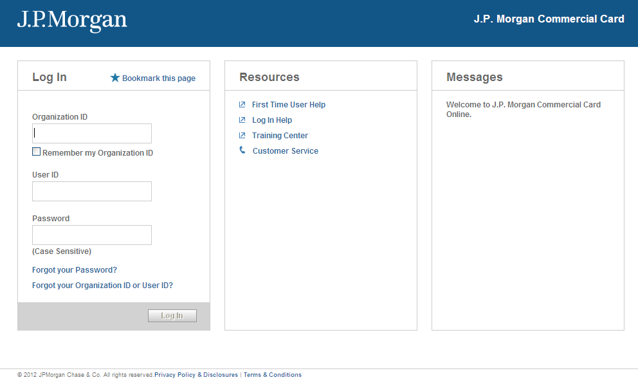
Log In for the First Time
Notes:
This is the new Log In Screen. Anytime you launch a PaymentNet session, you will be taken here.
The first time you log in, you will need to sign in using three pieces of information you would have gotten directly from JP Morgan via two emails:
The first email contained your Organization ID and your User ID
The second email contained your temporary Password
To simplify your log in process going forward, check the box next to Remember my Organization ID to prompt the system to automatically populate it for you every time. Note: if you are accessing PaymentNet from a public computer, please do not select this option.
The Forgot my Password link allows you to reset your own password by clicking on it. You will no longer have to contact anyone else for a password reset.
There is also a link to Log In Help which you can click on to get immediate answers to any questions you have about this Log In process.
Once you have successfully entered your Organization ID, User ID and Password, you will be taken to the next screen where you will be begin the First Time Log In Setup.

Slide 15
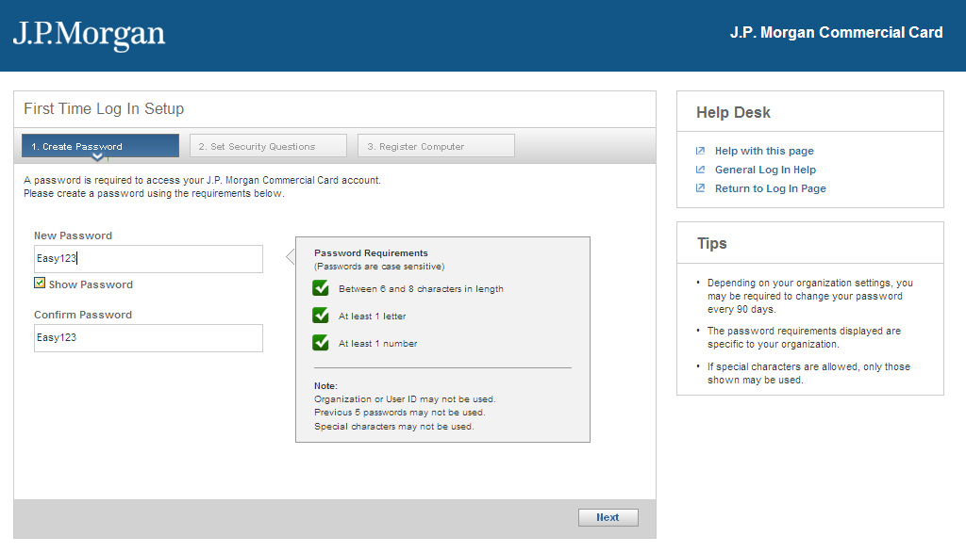
First Time Log In Setup
Notes:
After entering your credentials, you will land on the First Time Log In Setup screen. In order to set up your PaymentNet profile, you must complete three steps.
The first step is to create and confirm your new day to day password. As you are creating your new password, keep in the mind the Password Requirements.
There are new standards for creating passwords as indicated on the screen itself. All passwords must contain:
6-8 Characters
Be Alphanumeric (at least one letter and one number)
No Special Characters
Different from your User ID and Org ID
Different from your previous five (5) passwords
Once you are finished creating your new password, click on Next to submit and complete the first step.

Slide 16
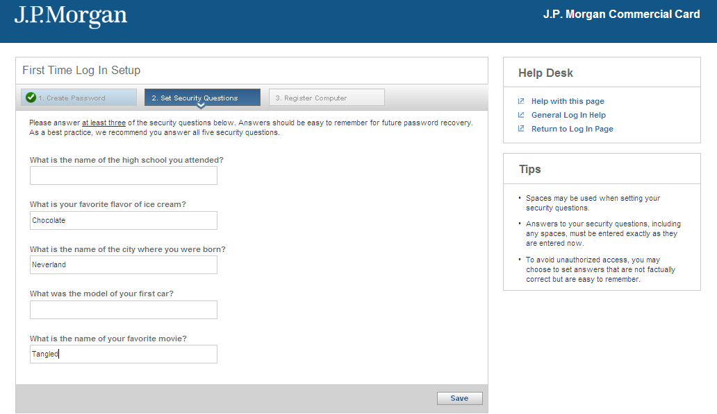
First Time Log In Setup
Notes:
Step two for the First Time Log In Setup is Setting your Security Questions. The answers to these questions will be used when you go through the Forgot your Password process.
You must answer at least three of the following questions when setting up your profile - although it is recommended that you answer all five. Responses to Security Questions are not case sensitive. If you ever want to change your answers to these questions, you can easily do that by clicking on the My Profile icon located on the upper right hand of the Home Screen. We will review that shortly.
When going through the Forgot your Password process, you have to accurately answer at least two of your security questions. If you are successful, you will then be sent, via email, a temporary password to log into PaymentNet. If you cannot answer two of the security questions correctly, then you will need to contact your Program Administrator to have them reset your password manually.
Note that after you’ve been set up the first time, this screen will never trigger again.

Slide 17
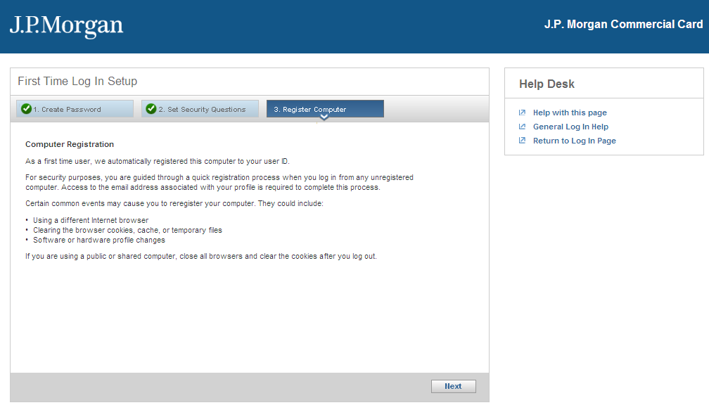
First Time Log In Setup
Notes:
Step three is Register Computer. As a first time user, your computer will automatically be registered to your user ID. At this point just click on Next to complete the process.
Go to the next slide to see an example of manually registering your computer.

Slide 18
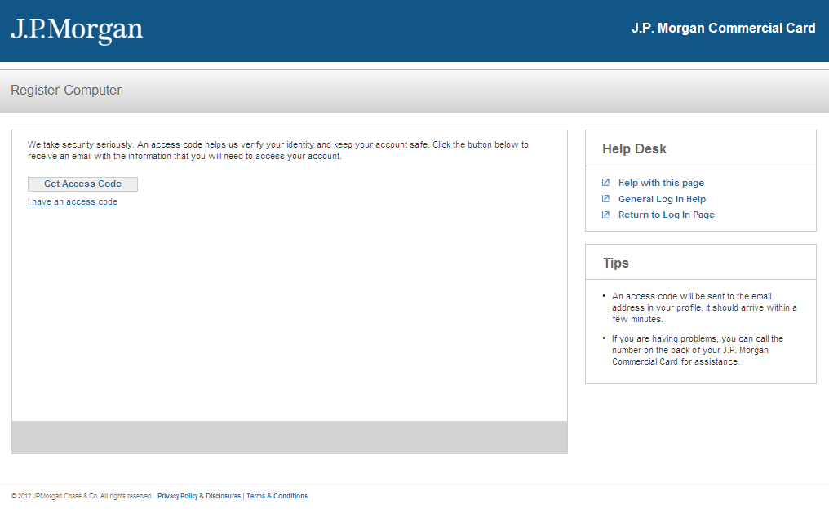
Log In from Unregistered Computer
Notes:
If on a subsequent visit to PaymentNet, you are logging in with an unregistered computer, you will be guided through a quick registration process.
In order to register your computer, you need to request an Access Code by clicking on Get Access Code. The Access Code will be sent to the email that is on file in PaymentNet.

Slide 19
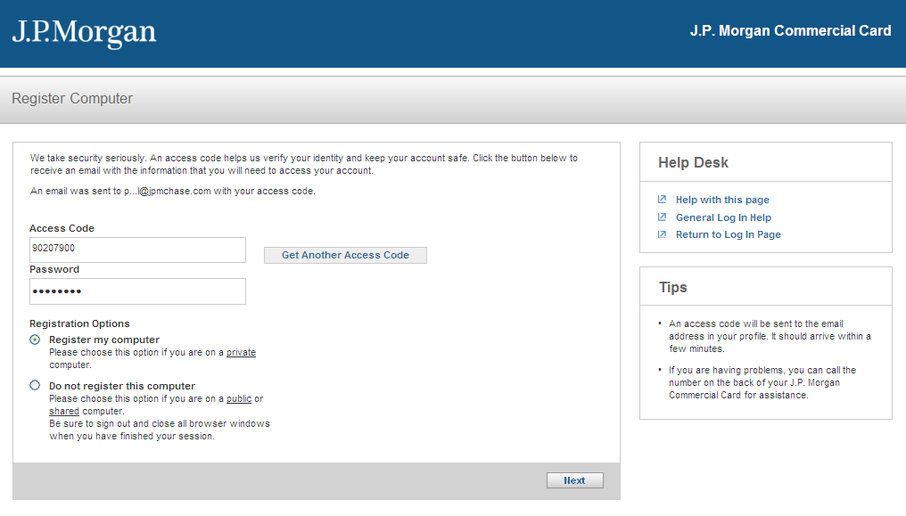
Log In from Unregistered Computer
Notes:
The Access Code you receive will be entered in the Access Code field. You will also enter your password in the Password field. If you are unsure as to which email your Access Code was sent to, you can look above the Access Code field where you will see the first and last letter of the email used.
You will then need to choose one of the Registration Options located on the bottom left. Once you have chosen one, click Next to complete the registration.
Certain common events may also cause you to reregister your computer. They include:
Using a different Internet browser
Clearing the browser cookies, cache, or temporary files
Software or hardware profile changes
Now that you have registered your computer, let’s take a look at what happens when you launch PaymentNet.

Slide 20
Welcome
Home Page
Notes:
The Welcome Screen, which is your Home Page, is launched after each successful log on. It is an enhanced screen which provides the Cardholder with immediate valuable information. Remember, this is one of the new features we briefly discussed.
Let’s take a look at your new Home Page.

Slide 21
The Welcome Screen
Notes:
The Welcome Screen populates as your Home page whenever you click on the Home Icon found at the top right of the page (the icon looks like a little house).
There are some new features that you will want to become very familiar with:
Messages - This is where any messages from either your Program Administrator or JP Morgan will be displayed. An example message is shown above ‘Welcome to Cardholder Task Training!’
Items Awaiting Your Action – This provides you with immediate awareness about key actions you need to take care of such as transactions for you to review, and access to files that are now available for you to download.
Icons (Upper Right Corner)
Home Page – As we just said, clicking on this Icon at any time will bring you back to this Welcome Screen.
Contact Information – This icon contains the name and number of the person(s) in our organization that will act as your point of contact regarding any questions with PaymentNet.
My Profile – This icon allows you access to your personal settings which you will maintain the information on. We will review this in detail next.
Log Out - It is recommended that you always use this icon when logging out.
Menu Bar contains the Modules you will need to access to complete your tasks. In Legacy PaymentNet, many functions were accessed through one menu. All user actions are now accessed and grouped into several modules which may include:
Transactions
Reports
Payments (if applicable)
Help
Let us begin by reviewing the My Profile Icon found on the upper right hand of the Menu bar.

Slide 22
My Profile
General Info – Screen Views - Accounts
Notes:
The My Profile Icon is used to enter general information about yourself, your bank information (if applicable), and your screen view preferences and provides you with a view of each of your credit card accounts.
The My Profile information displayed applies only to the logged in user. Changes made here will not be applied system-wide.
Once you click on the My Profile Icon, you will notice four tabs that lead to screens that you will need to complete and keep updated.
Let’s take a deeper look into each of the four tabs located within the My Profile Section.

Slide 23
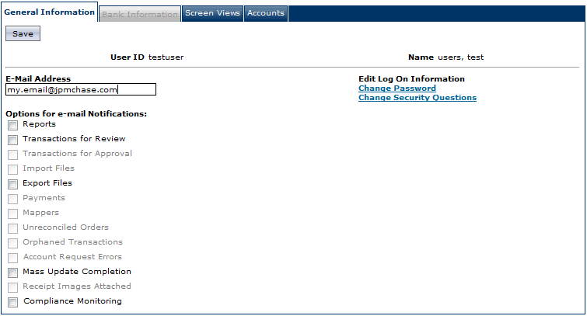
Change Password and Security Questions
Notes:
The first tab is labeled General Information and allows you to complete the following tasks found on the right-hand side of this screen:
Change Password – you can click here to change your password at any time.
Change Security Questions – this is where you would change your answers to any of the security questions you originally answered when setting up your password and computer for the first time.
Let’s move over to the left-side of this screen.

Slide 24
Change Password and Security Questions
Notes:
The first tab is labeled General Information and allows you to complete the following tasks found on the right-hand side of this screen:
Change Password – you can click here to change your password at any time.
Change Security Questions – this is where you would change your answers to any of the security questions you originally answered when setting up your password and computer for the first time.
Let’s move over to the left-side of this screen.

Slide 25
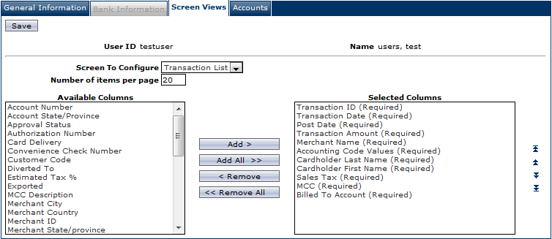
My Profile > Screen Views Tab
Notes:
As a Cardholder you will be familiar with the Transaction List. The updated platform is very similar to what you saw in Legacy.
The Screen Views tab is where you will set your preferences for your Transaction List. This includes the option to configure and choose viewable columns, column order, and number of items to be displayed on the list screen.
Note that if the word Required is listed after the column name, that item cannot be removed, however you can change the column order according to your viewing preference.
REMEMBER: Make sure to always click on Save whenever you change anything on any screen. A green confirmation message will appear after the Save button has been clicked if it has been successful. If not, a red-printed message will appear indicating where an error occurred.
Let’s move to our last tab under the My Profile page entitled Accounts.

Slide 26
My Profile > Accounts Tab
Notes:
The Accounts tab lists all of the Credit Card Accounts that are associated with you. This screen gives you visibility to do the following at any time:
View Payments
View account details
Choose your Default account if you have more than one
View card status
Select statement delivery option as either electronic or mailed
View your Statement
The review of the My Profile tabs is now complete.
Remember that these tabs allow you to set preferences and are easily edited by you when needed. No one else can change these details. Only you, when logged on, will be able to edit any of these fields.
Now that we have reviewed the Welcome Screen and My Profile, let’s move right into the review of the Menu Bar where you will access the Transaction Module.

Slide 27
Transactions Module
Manage – Auth/Declines – Query - Statements
Notes:
The Transactions Module in PaymentNet allows you to manage transaction details and settings and make real-time updates.
From the Transactions Module you will be able to complete the following tasks:
Manage and Update Transactions
Perform Mass Updates
View Transaction Authorization and Decline reasons
Create an Advanced Query
Download Monthly Statements
Let’s review what you will need to know when completing these tasks in the Transaction Module.

Slide 28
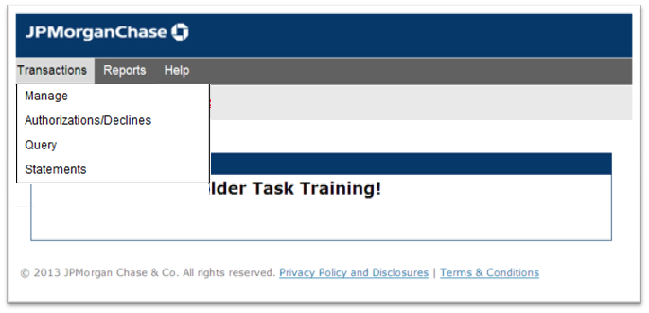
Transaction Submenus
Notes:
When you select the Transactions Module you will find several submenu options:
Manage: The Manage submenu takes you to the Transaction List Screen which is the starting point for most of the work to be done in the Transaction area.
Mass Update Requests (Optional): The Mass Update Request submenu lists Mass Updates that have been requested and their status.
Authorizations/Declines: The Authorization/Declines submenu lists any declined transactions and pending authorizations for a given account. This screen displays real-time information. Account data is live and displays activity for the last 7 days. You would be able to see why a transaction was declined.
Query: The Query Submenu takes you to the Advanced Query screen to conduct specific queries for transactions.
Statements: The Statement submenu takes you to the Statement Details screen where current and past statements can be viewed by you.

Slide 29
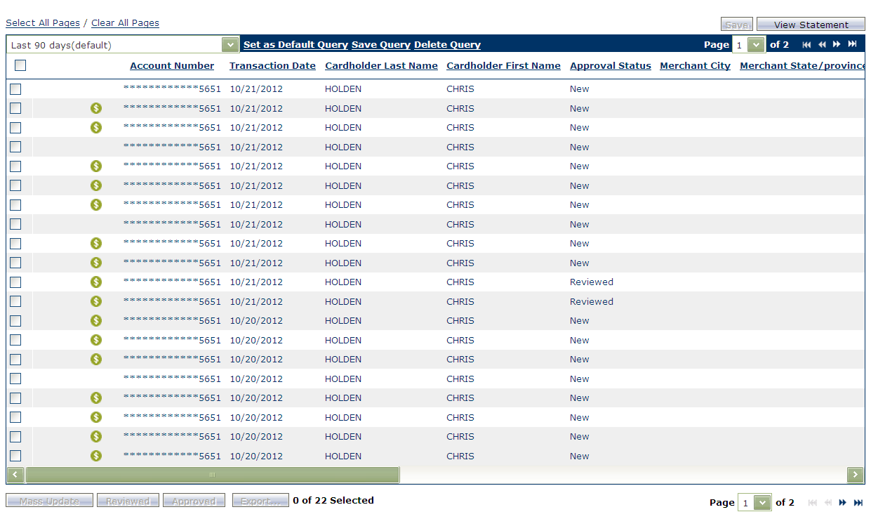
Manage Transactions from Transaction List Screen
Notes:
When selecting the Manage submenu, the Transaction List screen will populate.
The Transaction List screen displays transactions which have posted to your account.
NOTE: If you have created, saved and defaulted a query, your Transaction List screen would display according to that query.
The Transaction List screen is your starting point to complete many of your key cardholder tasks:
View Transaction Details
View Statements
Perform Mass Updates (if applicable)
View Addendum Information
Review Transactions
This screen would also be used to set up additional queries that you would like to save for future use. Let’s take a closer look at Advanced Queries. To get there, we would click on the Advanced link found in the upper right corner of the screen.

Slide 30
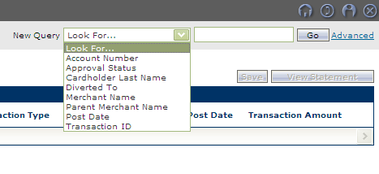
Query Options
Quick Query
Advanced Query
Notes:
NOTE: Data older than 30 days is available only by performing an Advanced Query.
The Advanced link found on the screen is where you will go to conduct more specific queries for the transactions you are searching for.
You can also save a query for future use by following these steps:
Select New Query from Query dropdown in upper right hand corner
Enter a required date range
Set criteria (optional)
Limit by hierarchy (optional)
Set the sort order of the columns (optional)
Process the query
Save query
Name the query
Set as Default (optional)
Let’s look at a full Transaction List again to learn how to work with multiple transactions.

Slide 31
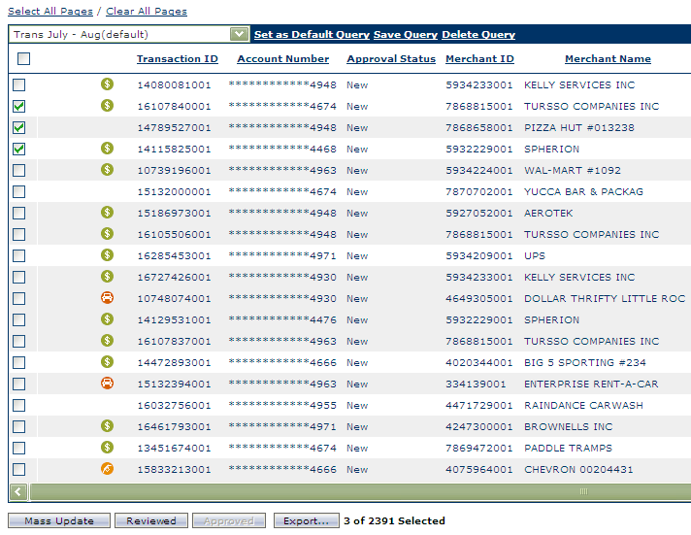
Multi-Select
Notes:
Multi-select is a new feature in PaymentNet that allows you to choose and work with all transactions in a given view or just a few of them. Multi-select is available in many list screens throughout PaymentNet. The functionality of this feature is the same regardless of the type of records you are selecting.
By choosing the Select All Pages link at the top of the List page, you can select every record of every screen of transactions.
In order to select only a few transactions at once, click the checkbox next to each Transaction that you want to work with.
From the bottom of this screen you can Mass Update, Review or Export the specific transactions you choose:
To Mass Update, simply click the Mass Update button and you will be moved to the next screen.
To Review, simply click on the Review button and these transactions will be updated and marked as Reviewed.
To Export, simply click on the Export button to be given an option for the type of resulting download needed.

Slide 32
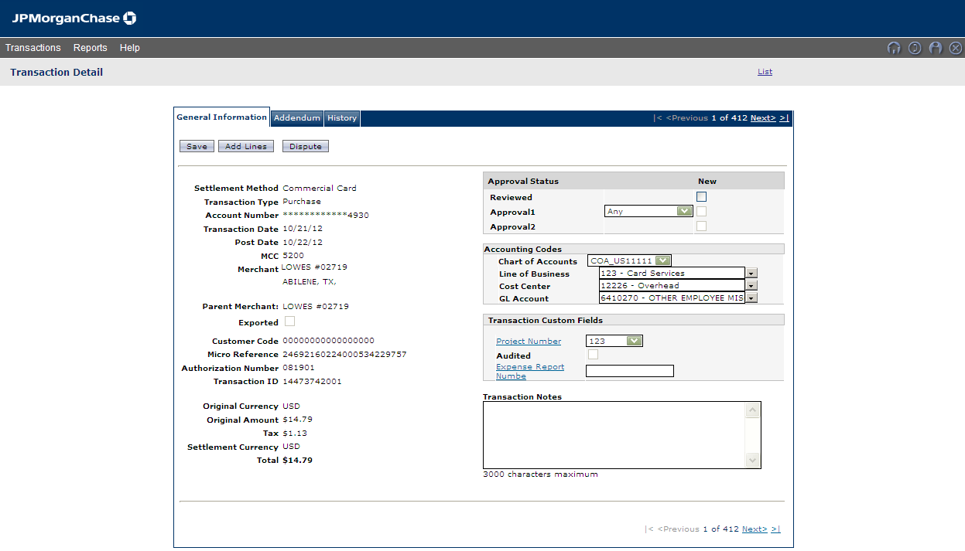
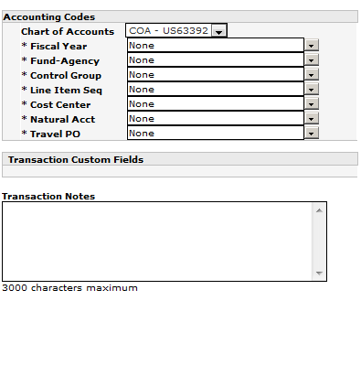
Transaction Detail > General Information Tab
Notes:
From the Transaction List, you can click on a specific transaction to view the specific details of that transaction. By selecting it, the Transaction Detail screen is populated.
The first tab is called General Information which provides an immediate summary of some of the information about that transaction. Let’s take a look at it by reading down the items listed.
Now, let’s move over to the information found on the right side of this tab.

Slide 33
Transaction Detail > General Information Tab
Notes:
From this part of the tab, a Cardholder can click the Review checkbox after reviewing a transaction and then select an approver to send their transaction on to. Not picture but also available under the Approval Status is the accounting code allocations. There you will be able to choose the accounting codes for this transaction.
Additionally, the Transaction Notes field is found here and this is where you will have to complete a note in the designated box.

Slide 34
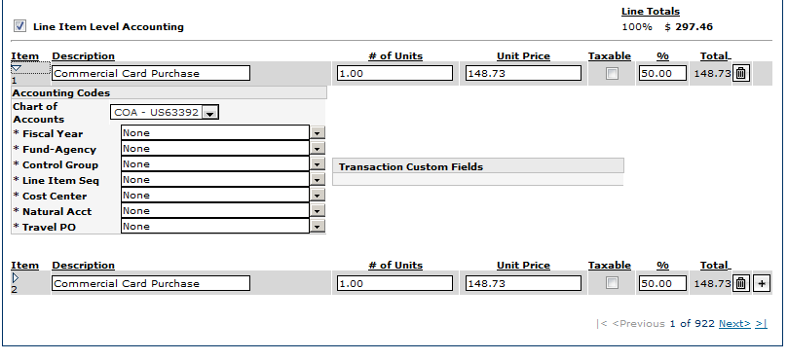
Accounting Codes by Line Item Level
Notes:
Cardholders can split their transactions from the General Information tab into different lines of accounting by following these steps:
Click the Add Lines button
Enter the number of lines to add to the transaction
Click the Add button
Complete the fields that display for each split or line
Click Save
Let’s look at how you would edit each line.
When splitting a transaction, the Accounting Codes can be accessed for each line item by selecting the drop-down arrow.
In this example, sample accounting fields such as Company and Cost Center and GL are available to be populated.
A new and enhanced feature allows the Cardholder to easily add additional lines or delete incorrect lines without having to begin the splitting all over again. So if you need to another split or delete an extra line, it is now an easy and quick process. After adding or deleting an accounting line, be sure to check the % field for each line, especially the last line since it will always be effected by any changes.
By clicking on the plus sign you can easily add additional splits. By clicking on the trash can icon, you can easily delete any lines entered in error.
There is a second tab of the Transaction Detail screen where you will find Addendum Detail.
Let’s look at that next.

Slide 35
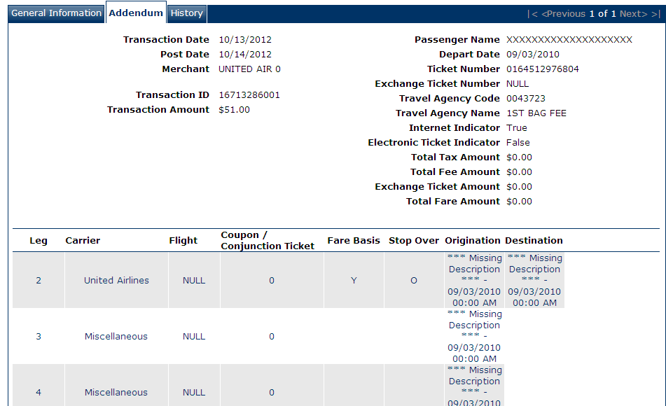
Transaction Details > Addendum Details
ABC Air
ABC Air
Notes:
The Addendum tab will show any Level 2 or Level 3 data sent by the Merchant.
If a merchant, attaches addendum details to a transaction, then you can view the addendum details here. For example, an airline ticket purchase will include details about the flight including, Flight number, Depart Date, Travel Agency Codes and legs of the trip.
If a merchant does not provide addendum details, then the Addendum tab is inactive and cannot be accessed.
If addendum detail is available, a small icon displays in the Transaction ID column on the Transaction List screen.
For Level 3 data, there are several types of addendum data including Airline, Hotel, Car Rentals, Purchases, etc., from which addendum data will populate. Each type of merchant will display different information on this tab.

Slide 36
Transaction List > View Statement
Notes:
One last area to cover regarding Transactions includes viewing and printing your Statement.
From the Transaction Detail list you can select the View Statement link at the upper right top and you will be taken directly to your current statement. Please note that you will may find links to your statements from other screens as well.
In Legacy PaymentNet, there was a quasi-statement created from an advanced query that didn’t always match the processor statement. With this updated PaymentNet platform, the statement you view online will always match the statement received in the mail.
Remember: The current statement will not be available until up to 48 hours after the billing cycle is closed.
Now that the review of the Transaction Modules is complete, let’s take a look at Reports and highlight any additional information you may need to know about the PaymentNet platform update.

Slide 37
Reports Module
Create - Download
Notes:
The Reports Module provides two submenu options for you to choose from. Let’s discuss them now.

Slide 38
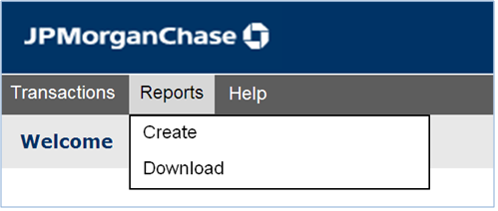
Report Submenus
Create populates the Report List screen which is the starting point for creating or scheduling reports.
Download populates the Downloads screen which displays all processed and scheduled reports and is also the place where files can be downloaded or deleted.
Notes:
The submenus found under the Reports Module are:
Create: The Create menu takes you to the Report List screen. The Report List screen is also the starting point for creating or scheduling reports.
Download - The Available Downloads screen displays all processed reports. From this screen you can download or delete reports. Once reports are processed, you will see a message on your Home Page in the Items Awaiting Your Action section indicating that you have Available Download Files for your review.
Remember that reports can be generated in Adobe PDF, Microsoft Excel, or CSV. Reports can no longer be generated in MS Word.
Let’s review the Report List in the next slide which is accessed by clicking on Create.

Slide 39
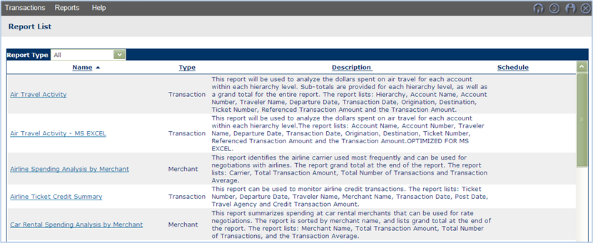
Reports
Notes:
The Report List screen displays a comprehensive list of reports that you as a Cardholder have access to as designated by your organization.
You can filter your report list by clicking on the Report Type drop-down menu. In the next slide, we will discuss saving your report criteria for future use. That report criteria becomes available under My Saved Reports which is also found in the Report Type drop-down menu.
Click on the Report that you would like to process. You will be taken to a screen where you will be able to choose criteria which will determine which transactions will be pulled into your report.
Let’s move to the next slide to see how to choose criteria.

Slide 40
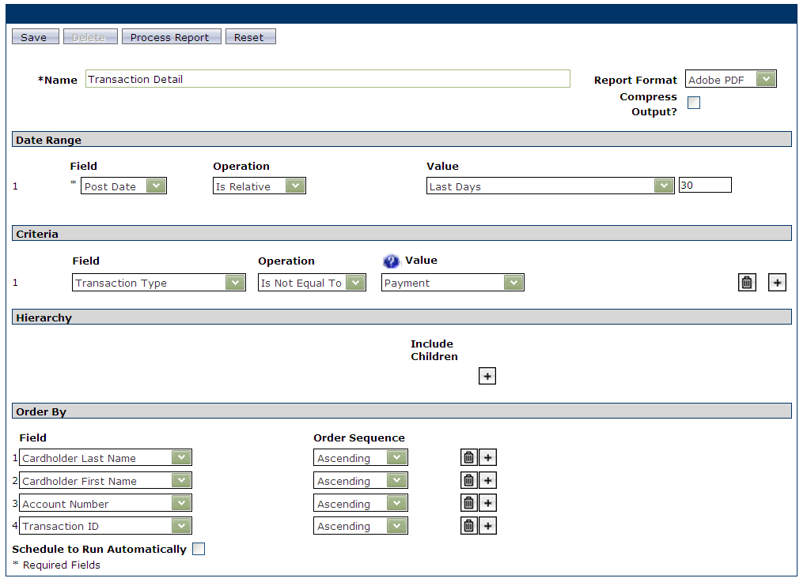
Schedule a Report to Run Automatically
Notes:
As you may have noticed, running a report is almost identical to running an advanced query. The fields available are:
Name - You can name your report if you wish to saved the criteria for future use.
Report Format - You have a choice of Adobe PDF, Excel and CSV.
Date Range – A Date Range is required to filter transactions to be included.
Criteria – Adding Criteria will help further filter transactions to be included. (Optional)
Hierarchy - Adding a Hierarchy will help further filter transactions to be included. (Optional)
Order by – Adding Order By fields will sort transactions included in the report. (Optional)
Additionally, you can schedule a report to be run automatically.
To schedule a report, check the Schedule to Run Automatically box and then choose the frequency schedule of the report. Frequency options include: daily, weekly, monthly or cycles.
Once the report has been processed, it will be available for download via Reports > Downloads.
For those Cardholders who make your own payments, let’s review a few things that you need to know about setting up payments in PaymentNet.

Slide 41
Help Module
Help for this Page – Help Index
Notes:
The Help Module allows all users to access and search for information in many different ways.

Slide 42
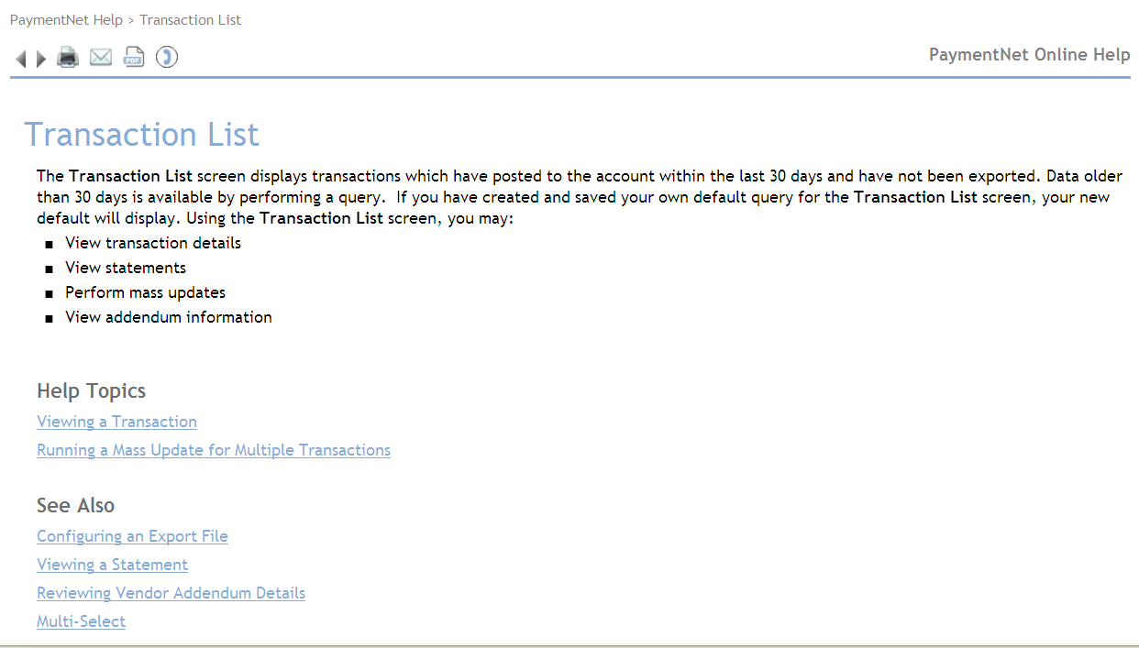
Help for this Page – Transaction List Page
Notes:
You will find the Help Module listed on your main task bar alongside the Transactions, Reports and Payments Modules.
Once you click on the Module, you will find two sub-menus as shown above:
Help For This Page which allows you to access the Help Guide from any page within PaymentNet.
Help Index which takes you to the entire help information guide from which you can begin a search.
For example, if you select Help For This Page from the Transactions > Manage screen as shown above, you will see an overview of the screen as well as links to each of the actions that can be performed from that screen.

Slide 43
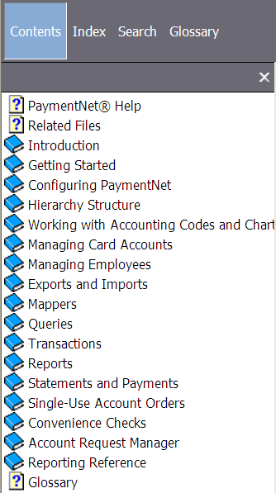
Help Index
Notes:
The Help Index allows you to search in various ways. Let’s review what each of these Help methods will provide you with by referring to the slide above.
Contents: This option allows you to find the desired topic by choosing the appropriate category on the left and “drilling into” the topic from there.
Index: This is an alphabetical list of keywords within the PaymentNet4 help guide. You can scroll to the desired index term or search for it in the “Find” field.
Search: This feature will search for a given term throughout the documentation, and display all topics that include that term. You can even select a yellow highlight feature to locate the term easily on each page displayed.
Glossary: Common industry and system terms are defined in this tab.
Also note that you will always see a Topic Tree on the left hand side for faster access to key topics found within PaymentNet.
It is strongly encouraged that you always refer to the Help Index or Help For This Page whenever you have a question about a process, a procedure, a term or if you just need clarification of how to perform a task correctly.

Slide 44
Help Screen Contents Display
Notes:
Another point to make is that within PaymentNet you will always find Related Files, User Documentation, User Guides and Quick Reference Cards available to you whether you are logged into the system or not.
Whenever you need additional or immediate information, it is best practice to search the Help Guides for resolution.
Note that you now have an option to provide feedback to those that maintain the actual information found by clicking on the envelope link found above. Your input ensures that this tool remains robust and up-to-date.

Slide 45
24/7 Link to Online Help
https://www.paymentnet.jpmorgan.com/help/PaymentNet4.html
Notes:
Great News!
Whether you are logged into PaymentNet or not, you can link into PaymentNet Help by directly clicking on the link above. You can have any of your questions answered without having to wait.

Slide 46
Thank you Cardholders!
THIS MARKS THE END OF THE CARDHOLDER TRAINING POWERPOINT DECK.
Notes:
Instruction to Program Administrator: This is the last slide in which you can indicate how the Cardholders would reach out for help within your organization.
Are there any questions about this Cardholder Training Deck?
Let me remind you that along with this training deck there is fully-scripted Notes page under each slide which speaks directly to all of the information found on each slide.
We will send the deck on to you following this training so you can use it as an additional resource during your initial migration to the updated PaymentNet.
Good Luck and enjoy all of the enhancements!

